Slide 1
Indian Institute of Engineering Science and Technology, Shibpur
Web Technology Lab
Group - 6
Milind Agarwal
Vivek sharma
Suprotik Dey

Slide 2
Online Marks Submission
Faculty have to register in the system. Upon login he will be displayed the subjects he taught with in the semester. Clicking on the subject, the list of students (with roll number) appeared for the examination will appear. Faculty will put the marks. An edit option will be provided. Edit will stop functioning after final submission. HOD has the right to check whether all marks from his department have been submitted or not. After his approval/ checking a faculty can finally submit his marks. Controller of examination can find any disputes (marks not submitted) if happens.

Slide 3
Requirement Analysis
An online system for students and faculties to check and upload marks per semester.
The problem statement can be broken down into the following sub parts.
A signup/signin section for both students and faculties.
A student can login and view his/her marks upto the current semester.
A faculty after logging in can upload the marks of a subject he/she teaches for the current semester and forward it to the HoD for approval.
The HoD after reviewing, approves the marks if all entries are correct, else he generates a flag notifying the respective faculty about discrepancy.

Slide 4
5. If there was any error, the faculty rechecks the error and rectify it, and again forwards it to the HoD for reviewing.
6. If the received entries are error free then the marks are finally submitted by the faculty to the database.
7. After all submissions, the Controller of Examination finally checks if there is any discrepancy in the database.

Slide 5
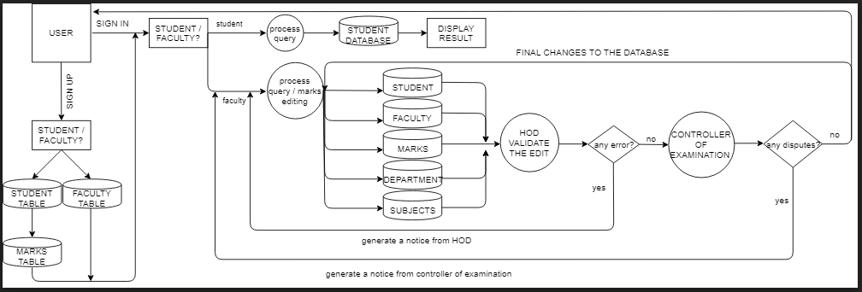
DATA FLOW DIAGRAM

Slide 6
